Slide 1

INTRODUCTION TO ENGLISH II - ISJ1K3
Department of Information System
School of Industrial Engineering
Telkom University
Notes:
Welcome to English II, My name’s miss Lisa and I will guide you to complete this lesson. This ppt discuss the syllabus and lesson plan of English II

Slide 2

1. Overview ISJ1K3
2. Blended learning
3. Q & A

Slide 3
LESSON PLAN
Meeting | Date | Class Meeting | Room | Materials | TASK | QUIZ | MEDIA
Week 1 | 26 Sept 22 | Onsite | Classroom | Lecture note 1 | Task 1: Free writing EPRT SCORE | Quiz 1 | LMS
Week 2 | 03 Oct’ 22 | Online | Gmeet , Forum LMS | Lecture note 2 | Task 2: Infographics | - | LMS
Week 3 | 10 Oct’ 22 | Online | Gmeet , Forum LMS | Lecture note 3 | Task 3: Descriptive paragraph | - | LMS
Week 4 | 17 Oct’ 22 | Onsite | Classroom | Lecture note 4 | Task 4: Explanatory paragraph | Quiz 2 | LMS
Week 5 | 24 Oct’ 22 | Online | Gmeet , Forum LMS | Lecture note 5 | Task 5: Digital Story (video) | Quiz 3 | LMS
Week 6 | 31 Oct’ 22 | Onsite | Classroom | Lecture note 6 | Task 6.1: Group Presentation | - | LMS
Week 7 | 7 Nov’ 22 | Onsite | Classroom | Lecture note 7 | Task 6.2: Group Presentation | Quiz 4 | LMS
WEEK 8 | 14 NOV’ 22 | ONSITE | CLASSROOM | MID SEMESTER TEST |  |  | LMS
Week 9 | 21 Nov’22 | Online | Gmeet , Forum LMS | Lecture note 8 | Task 7: Brainstorming | Quiz 5 | LMS
Week 10 | 28 Nov’22 | Onsite | Classroom | Lecture note 9 | Task 8: Thesis statement | - | LMS
Week 11 | 5 Des’ 22 | Online | Gmeet , Forum LMS | Lecture note 10 | Task 9: Outline | - | LMS
Week 12 | 12 Des’22 | Online | Gmeet , Forum LMS | Lecture note 11 | Task 10.1: Introductory paragraph | - | LMS
Week 13 | 19 Des’22 | Onsite | Classroom | Lecture note 12 | Task 10.2: Body paragraph | Quiz 6 | LMS
Week14 | 26 Des’ 22 | Online | Gmeet , Forum LMS | Lecture note 13 | Task 10.3: Concluding paragraph | - | LMS
Week 15 | 2 Jan’ 23 | Onsite | Classroom | Lecture note 14 | Task 11: Digital mini magazine | - | LMS
Week 16 | 9 Jan’ 23 | Onsite | Classroom | FINAL TEST |  |  | LMS
Notes:
This semester we will conduct a blended learning method. This will have 2 type of meeting; online or using google meet or zoom meeting and LMS, and onsite means we will do face to face meeting in a classroom but, we still use LMS, completing the activity completion. In LMS, there are 5 activity that you must complete. Learn the lecture note, engage the forum/discussion, do the quiz if it is available, because we only have 6 times quizzes. Next activity are watching some videos in external link, and lastly submit the task given in every week. You may chaeck LMS regularly and make sure you do the activity completion before the deadline.

Slide 4







Notes:
There are two main materials for English II. In paragraph writing, we set this materials from week 2 – week 7. there are several tasks related to this making infographics, poster, and digital story. and we will do the evaluation in week 8, UTS. For the second main materials, we will discuss essay writing. From the prewriting step until putting all togethers into digital magazine or online articles. For the evaluation we will held in week 16.

Slide 5




16 Meetings
Blended learning

Slide 6








Join class ontime

Slide 7
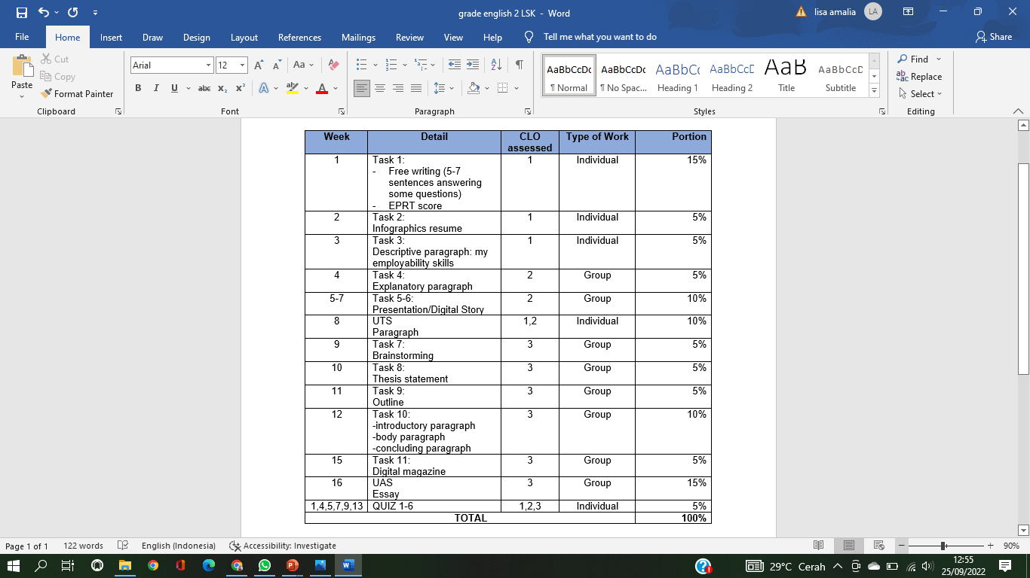
Tasks: 70%
Quiz : 5%
ExamS: 25%
Notes:
There are 11 tasks for English II, the total grade of the task is 70%, the rest are the quiz 5% and the mid and final test (25%)

Slide 8
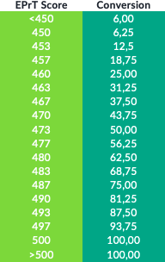

Slide 9
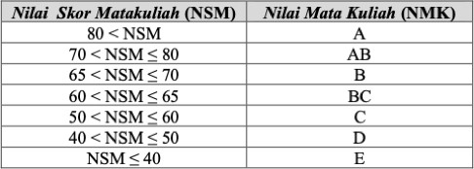
Notes:
To get A score, you must at least collect 80,01 % of the total grade.

Slide 10

Notes:
That’s about the lesson plan of English II.

